Slide 1
CANIETI Nacional Workshop “Best Practices for Business and Educational Partnerships”
November 2012
Mexico City

Slide 2
Session One
Introductions and meeting objectives
Discussion of the demand for education and industry partnerships in Mexico
Benefits of sharing best practices in industry-education partnerships

Slide 3
Introductions and Presentation Team
Santiago Guitierrez – Presidente Nacional CANIETI
Jorge Klor de Alva – President, Nexus Research and Policy Center
Tim Welsh – Senior Vice President, University of Phoenix
Glenda Whetten – Director of Int’l Academic Affairs, Apollo Global
Ralf Peters – Presidente de Apollo Global México y Centroamérica
Eric Pearse – Rector Académico, ULA
Elena Flores – Dirección Programas Ejecutivos, ULA
Rocío García – Dirección Programas Ejecutivos, ULA

Slide 4
The Apollo Group
Shared Services
Marketing
Student Services
Academics/Curriculum
Learning Technology
Industry Partnerships
Thought Leadership
Best Practice Sharing
Best Practice Sharing
Higher Education
Professional Education
Higher Education
Higher Education
Higher Education
United Kingdom
(11 European countries)
Chile
Mexico
United States
Cross Learning Opportunities/Shared Services

Slide 5
Session Two
Why Apollo pursues partnerships with employers and industries
Terminology: workforce development, working adults, education to careers
Employers’ need for education programs geared to industry requirements
Educators’ need for employer involvement in education
Working adults’ need for flexible and relevant programs to support careers

Slide 6
Why Apollo Pursues Partnerships with Industry
Establishes educational institutions as a provider of workforce solutions for industry and employers
Creates opportunities for
Academic innovation
Career services for students
Educational research programs
Thought Leadership programs
Improves the relevance of education to employers

Slide 7
Key Partnership Terms
“Workforce Development”
“Working Adults”
“Education to Careers”

Slide 8
How Partnerships Help Employers and Educators
Identify workforce development needs by addressable market for Colleges/Schools at an industry scale
Create opportunities to increase the relevance of educational programs to employers and,
Redefines tuition assistance programs for employers as investments in human capital, not human resource costs.

Slide 9
Working Adults’ Needs
Flexible
Access
Career Relevance
Accredited
Employer endorsed
Based on industry requirements

Slide 10
Session Three
Importance of a consultative approach in partnering with industries
Imperative involvement of academic leaders in partnerships with employers
Attributes of successful leaders of educational partnerships
Benefits and elements of creating annual plans for educational partnerships

Slide 11
Consultative Approach: Translating Industry Needs into Educational Programs
Example of University of Phoenix’s National Industry Strategy Group
National Industry/Sector Associations
Prioritizes workforce development needs and solutions for industry
National Industry Strategy Group
Creates partnerships with workforce units of industry associations
Relevant Educational Programs
Develops industry specific educational pathways for working learners
Provides third-party validation
Helps UOPX calibrate its educational portfolio to industry workforce development needs
Helps professionalize careers in each industry by developing industry-relevant degree pathways for learners
11
Notes:
Operationally, NISG serves as a market-facing partner for the various colleges and schools at UOPX while also creating discrete vertical market teams. Each has two roles: an internal and an external, market-facing role:
Internally, within UOPX, NISG’s vertical market teams help rationalize the work with the relevant academic affairs and product marketing leaders in each college and school with industry workforce development needs and priorities. Vertical market teams underway and under development include those focused in Technology, Business, Healthcare and Nursing, Education and Criminal Justice & Security.
Externally, the vertical market teams create and formalize partnerships with the workforce development arms of national industry/sector associations. Through these partnerships, NISG helps UOPX calibrate its educational portfolio to nationally-recognized workforce development needs and priorities; presents occasion for industry-relevant thought leadership opportunities; and provides UOPX with third party validation and support by leading national industry/sector associations to member companies and prospective students within each market.

Slide 12
Competency Model
Workforce Development Programs Based on Industry/Employer Requirements

Slide 13
Involvement of Academic Leaders
How Apollo is Organized for Industry Partnerships
Industry Marketplace
Academic Program Development
National Industry Strategy Group
Marketing and Communications to Industry Leaders

Slide 14
Leadership Requirements and
Partnership Plans
Leadership Requirements for Partnering Organizations
Nationally prominent experts in workforce development / adult education
Annual research agenda into workforce development best practices
Established coalitions of employers and educators
Annual Partnership Plans
Jointly developed by educational institution and employer/industry
Multi-year
Programmatic orientation
The Importance of a Consultative Approach
Consultative, not transactional
Partner organizations work for a common cause for a common client
Coalitions of competitors organize to enhance the overall quality of national workforce

Slide 15
National Industry Workforce Information: US Manufacturing Industry

Slide 16
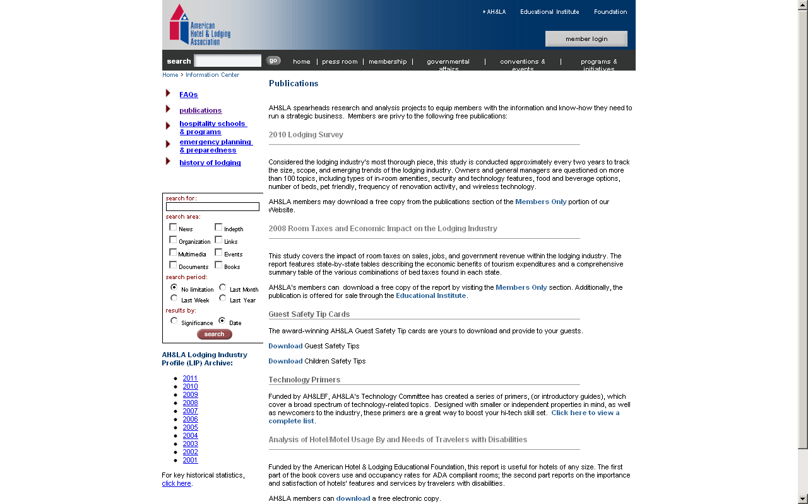
Industry Workforce Information: US Hospitality Industry

Slide 17
Industry Workforce Information: US Retail Industry

Slide 18
Session Four
Conocer
Mexico First
IMPULSA
Universitrónica
The ULA Experience: A Focus on Working Adults

Slide 19
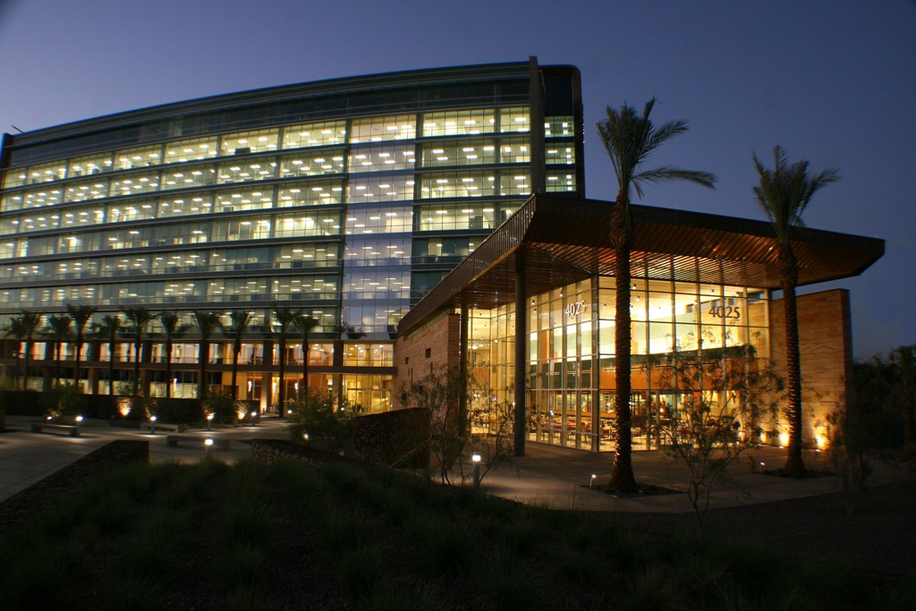
Session Five: Discussion

